Slide 1


Twitter Analysis
Version 1.0, July 2015
Author Ross Hightower
Product SAP HANA
Level Beginner
July 22, 2015
Focus
An introduction to the Twitter analysis curricuclum.
Public

Slide 2
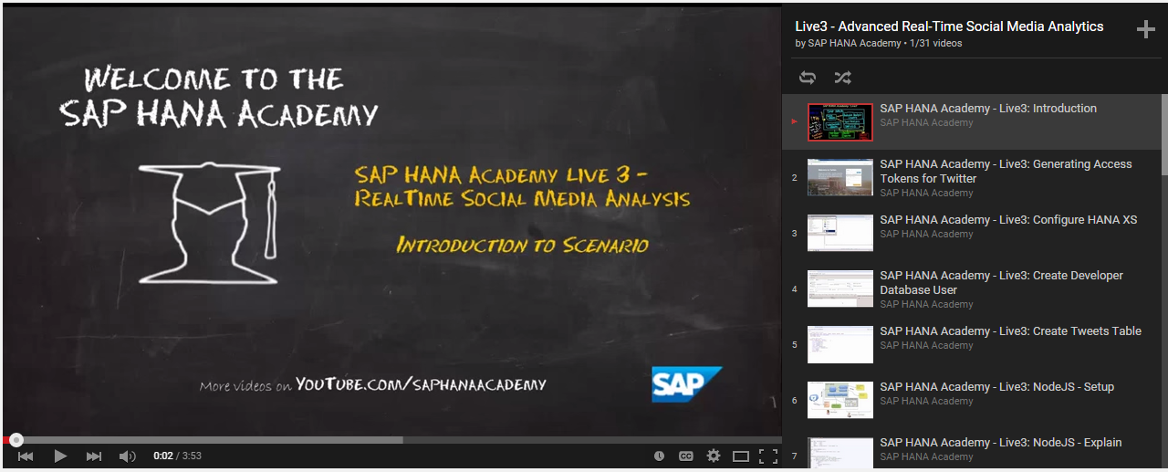
Live3 – Realtime Social Media Analysis on HANA Academy
https://www.youtube.com/watch?v=MvYHlIWDgnI&list=PLkzo92owKnVwOu5o437oYi6O3ynesWZ9K

Slide 3
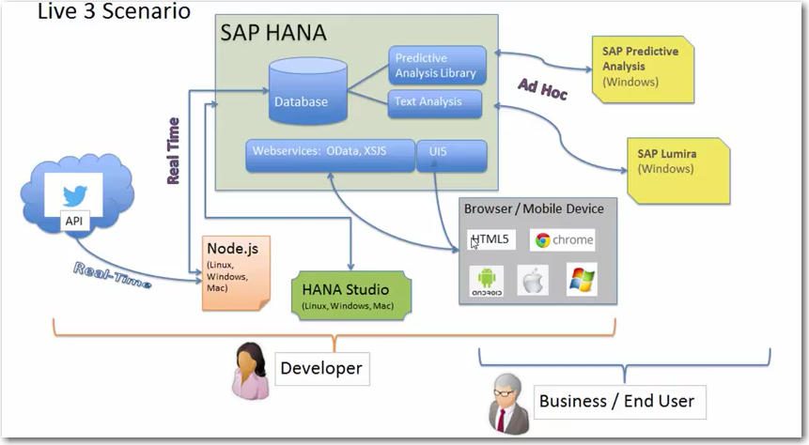

Slide 4
Node.js
Node.js is an open source, cross-platform runtime environment for server-side and networking applications.Node.js applications are written in JavaScript, and can be run within the Node.js runtime on OS X, Microsoft Windows, Linux, FreeBSD, NonStop, IBM AIX, IBM System z and IBM i.
Node.js, itself is pretty basic. However, a huge open-source community of developers have created a large number of node modules which provide virtually every type of functionality you can think of.
Node modules are managed using the node package manager (npm)
Node.js is used by eBay, Yahoo, Netflix, PayPal, LinkedIn an many others

Slide 5
Node Modules in the Twitter Capture Case
express - express includes much of the basic functionality required for a network application like handling HTTP requests and sending responses.
oauth – oauth implements the oAuth authentication method required by Twitter.
Node-tweets-stream –implements the API required to interact with Twitter applications.
hdb – hdb allows interaction with HANA including authentication and the ability to execute SQL commands.
emoji-strip - emoji-strip strips emojis from the tweets. It’s necessary because HANA does not support emojis.

Slide 6
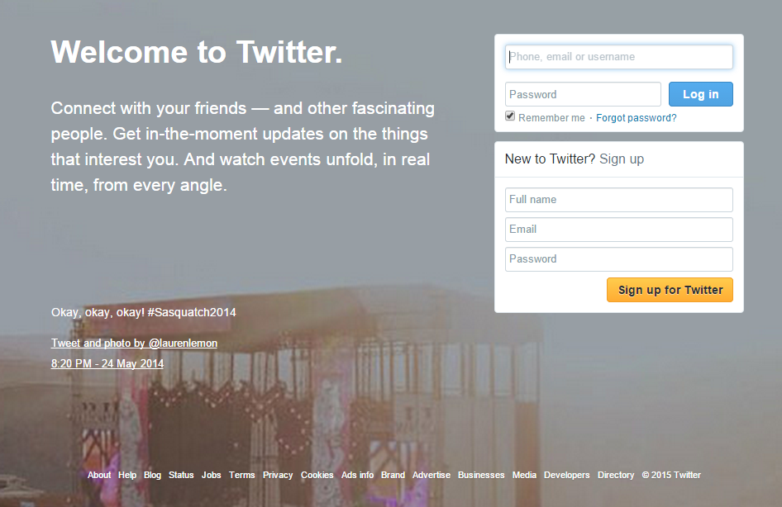
Twitter Application
In order to use the Twitter API you must create a Twitter application.
You will be provided with keys and
tokens the node.js application will use
to access the API.

Slide 7
Text Analysis
“…is a suite of natural-language processing capabilities based on linguistic, statistical and machine-learning algorithms that model and structure the information content of textual sources in multiple languages.”
Linguistic Analysis is the most fundamental form of text analysis - tokenization, stemming and part-of-speech tagging.
Entity Extraction is the identification of named entities (persons, organizations etc.), which eliminates the 'noise' in textual data by highlighting salient information.
Fact Extraction is a higher-level semantic processing that links entities as "facts" in domain-specific applications. For example, "Voice of the Customer" classifies sentiments with their corresponding topics.”
Sentiment Analysis is a type of Fact Extraction which attempts to interpret the sentiment of the source of the entities extracted from text and assign positive and negative sentiment to the entities.

Slide 8
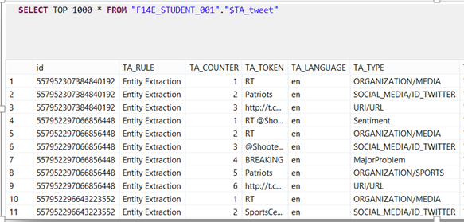
Text Analysis
The text analysis extracts
tokens from the tweets and
classifies them into various
types.

Slide 9
Output From Text Analysis
Columns | Description
Id | The id of the Tweet from Twitter. An id might appear in more than one record if multiple entities are extracted from the Tweet.
TA_RULE | The text analysis rule used to extract the entity.
TA_COUNTER | A count of the number of entities extracted from a Tweet. The first three records in the image above are extracted from the same Tweet so they have the same id but the counter increments for each entity.
TA_TOKEN | The text entity that is extracted.
TA_LANGUAGE | The language of the Tweet.
TA_TYPE | The type of the extracted token as classified by the configuration we used.

Slide 10
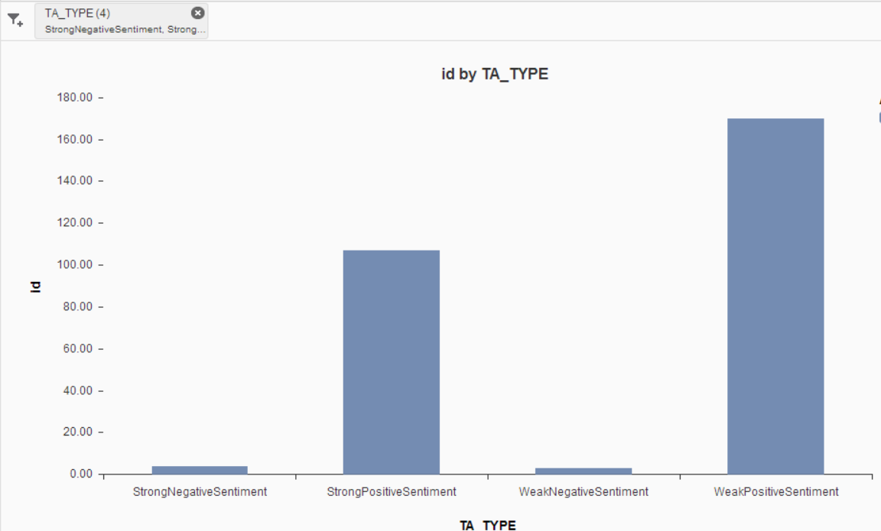
Sentiment
Some tokens are classified as sentiment.
Sentiment allows you to determine how people feel about something.

Slide 11
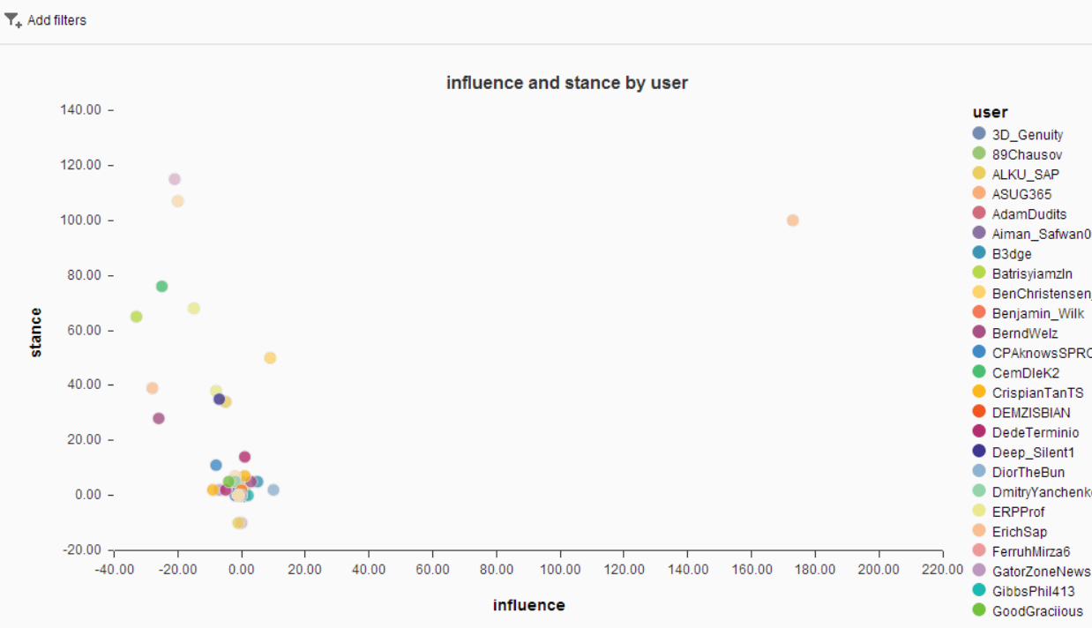
Stance and Influence
Stance and Influence allow you to identify who the thought leaders are and what their sentiment is.

Slide 12
Stance and Influence
Stance is how positive or negative someone is.
Influence is how many times a person’s tweets are retweeted or responded to
Stance = 5 * SP + 2 * WP – 5 * SN – 2 * WN
Where:
SP – Strong Positive
WP – Weak Positive
SN – Strong Negative
WN – Weak Negative

Slide 13
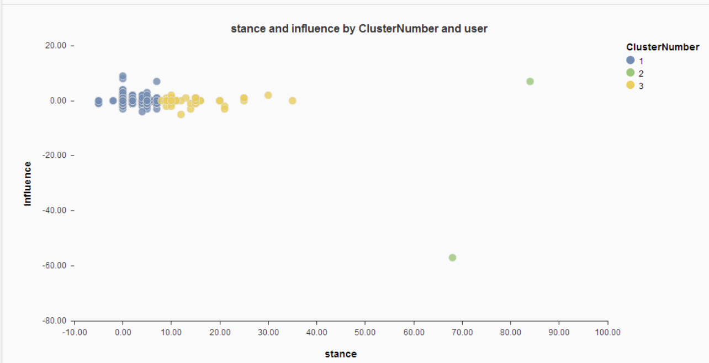
Cluster Analysis
Cluster analysis on the stance and influence allow you to see if there are clusters of thought on a topic

Slide 14
Cluster Analysis
Cluster analysis uses the KMeans algorithm HANA’s Predictive Analysis Library (PAL)
PAL_T_DATA
PAL_T_RESULTS
Describes input fields
Advanced Function Library (AFL) wrapper
Contains parameters to configure algorithm
PAL_T_PARAMS
PAL_T_CENTERS
Identifies input and output tables
KMeans Procedure
PAL_T_SIGNATURE

Slide 15
Thank you
Contact information:
Ross Hightower
hightowe@uwm.edu

Slide 18
Notes and Sources
Example Title, Author, Location yyyy, http://www.sap.com

